Slide 2


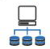




TRM Model – Detailed View
MANAGE TECHNOLOGY RISK
Cybersecurity
Third Party Governance
Resilience
Governance & Strategy
Innovation
Service Development
Incident, Problem & DR Management
Application Security
Vulnerability Management
Cyber Threat Intelligence
Security Monitoring
Adversary Hunt
Cyber Incident
Management
Network Security
Platform Security
Identity & Access
Management
Information Protection
Service Security
Vendor Onboarding
Vendor Maintenance
Vendor Service
Termination
Inter-Affiliate Agreements
Monitoring and
Maintenance
Asset Governance
Asset Inventory
Management
Asset Procurement and
Onboarding
Asset Disposal
Configuration
Management
Service Design
Service Desk
Service Governance
Service Operational Risk
Management
Change Preparation
Change Execution
Change Governance
Release Planning
Release Execution
Capacity Planning
Capacity Monitoring
and Review
Quality & Performance
Assessment
Availability Management
Performance Improvement
Lifecycle Planning
Remediation
Repeatability
Effectiveness
Knowledge Management
P&E Systems
Physical Security
Physical Access
Environmental Security
Organizational Structure
Prioritization & Decision
Making
Portfolio Management
Resource Management
Monitoring and Reporting
Strategy Planning &
Management
Business Planning
Policy Management
Communications
Risk Governance
Risk Identification &
Assessment
Risk Treatment
Risk Monitoring &
Reporting
Mergers, Acquisitions &
Transformational Activities
Tech Compliance
Requirements
Tech Compliance
Evaluation Reporting
Tech Compliance
Monitoring &Resolution
Recruit
Retain
Develop
Succession Management
Budgeting & Accounting
Cost Optimization
R&D Program
Industry Engagement
IP Management
Solution Prototyping
Product Development
Market Alignment
SDLC Governance
Requirements & Planning
Design
Implement
Testing
System Integration
Production Maintenance
& Operations
Program Governance
Project and Program
Planning
Project and Program
Execution
Enterprise Architecture
Strategy & Governance
Business Architecture
Data and Solution Architecture
DevOps Methodologies
DevOps Tooling
Deployment
Preparation
Identification & Analysis
Remediation
Results Aggregation
Prepare
Find
Analyze
Execute
Program Guidance &
Structure
Risk Assessment and BIA
Plan Development and
Implementation
Test, Training
and Evaluation
Cybersecurity Operations
Vendor Management
IT Asset Management
Capacity Management
Governance and Oversight
Technology Compliance
Research and Development
Delivery Lifecycle
Incident Management
Performance Management
Inter-Affiliate
Business Transformation
Problem Management
Strategy and Policy
Talent Management
Cybersecurity Engineering
IT Service Management
Program Management
Sustainability
BCP & DR
Finance Management
Technology Risk Management
Service Architecture
Change & Release Management
Physical and Environmental Security
Key:
TRM Domain
DevOps
TRM Control Objective
TRM Control Family

Slide 3
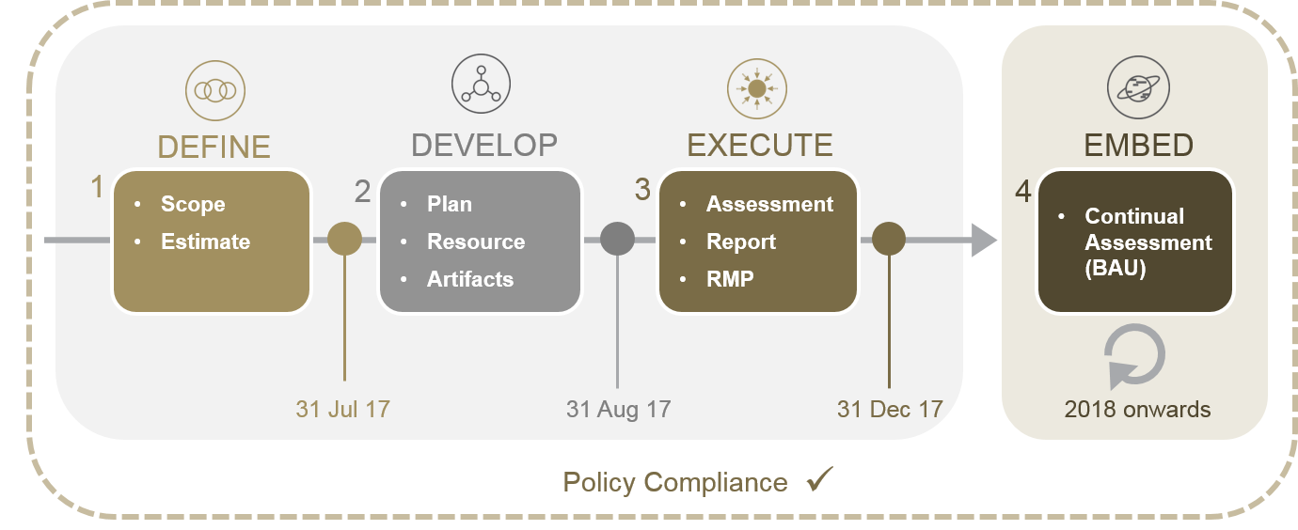
Overview
Policy dictates all RCSA Key Controls mitigating High inherent risks must be assessed by first line control owners. Policy Statement:
Key Controls mitigating High inherent risks whether performed by the Business/Business Partner, an internal affiliate or external third party (vendor) must be assessed by first line control owners using one of the techniques in the Control Assessment Methodology standard provided in Appendix B (I-G-037 Risk and Control Self-Assessment Policy, III.)
Define, develop and execute a tactical initiative to attain policy compliance by 31 Dec 2017
Embed continual assessment into BAU to comply with ongoing policy requirement
Technology Operational Risk will work with relevant Technology RCSA owners and leverage the Risk & Resiliency Monitoring Service (RRMS) to meet the policy requirement in an efficient and consistent way
High Level Approach
Team Overview
Technology
Operational Risk
Operational Risk SMEs
Risk & Resiliency
Monitoring
RRMS Control Assessment Team

Slide 4
Assessment Workflow & Roles
Activity |  | Description | Objectives | Owners | Key Stakeholders
 | 1 | Stakeholder Communication | A cut off date is considered twice a year to freeze the in-scope controls, Control Owner mapping etc. Inform all stakeholders of policy requirement and compliance approach | TCA Tech Op Risk | All
 | 2 | Initial meetings with stakeholders | Provide overview / expectations / timelines | TCA Tech Op Risk | RCSA POCs RCSA Owners
 |  |  | Scope and control assessment approach Request additional information (control owners/SMEs/evidence) Share control sets to respective RCSA POCs to coordinate evidence collection
 | 3 | Review controls and evidence | Low-level control review meeting(s) (number/scope to be determined) Agree evidence requirements and timelines | TCA | RCSA POCs Control Owners / SMEs Tech Op Risk
 | 4 | Collect evidence | Evidence collection (TCA Access/E-mail/SP) | TCA | RCSA POCs Control Owners / SMEs
 | 4a | Escalation (if required) | Past due evidence may trigger a 3-level escalation process | TCA Tech Ops Risk | See Escalation Process
 | 5 | Control effectiveness assessment against provided evidence | Review Evidence Conduct control assessment Request additional evidence (if required) Produce control assessment scripts Assess control effectiveness (using Technology Risk Assessment Methodology (TRAM) (Appx. A) | TCA | Tech Ops Risk
 | 6 | Report control assessment results | Produce control effectiveness RCSA reports | TCA Tech Op Risk | RCSA POCs Control Owners / SMEs TCA
 | 6a | Review and agree results | Review and agreement RCSA reports with stakeholders
 | 7 | Formal approval and closure | Approve final RCSA report Discuss and agree next steps Formal RCSA assessment closure & Upload final Report to RMP | Tech Op Risk TCA | RCSA POCs RCSA Owners
 | 8 | Risk Management Platform (RMP) Update | Document Gaps & Action plans in RMP Track action plans for closure | Tech Op Risk | RCSA POCs RCSA Owners CORM
0.
1.
Prep / Scoping
Comms.
Planning & Kick-off
2.
3.
Repeatable
Control Review
4.
4.a.
Evidence Collection
Escalation
5.
5b.
Control Assessment
Control Work papers
6.
6.a.
RCSA Reporting
Report Review
7.
Close-out & RMP Updates
8.
RMP – Gap and Action plans

Slide 5
Content Outline
RCSA Control Assessment - Requirements & Approach
2018 H1 Assessment cycle - Scope & Distribution
2018 H1 Assessment – RCSAs in Scope
Assessment Workflow & Roles
RCSA Control Assessment – Journey in Numbers
Control Assessment Results
High level overview
Results by Control Domains
Rating Distribution by RCSAs
The Team Behind
RCSA H1 2018
What Worked Well
Challenges
Next Steps
Appendix

Slide 6




Control Assessment journey in numbers
Evidences collected include but are not limited to
Data logs
Screenshots of systems with access restrictions
Project / Program Documentation
SharePoint sites
URLs
Emails
Assessment of key controls mitigating high inherent risks
3-Month Initiative
1200+
Evidences Collected
90+
12
RCSAs in-scope
Meetings
Meetings with
Control Owners, PoCs, Subject Matter Experts, RCSA Owners
11
Assessors
160+
Stakeholders involved
All of the above
Service Owners/Service leads
TRCSenior Management
Tech Ops Risk Management
CORM
266
Stakeholders Engaged
Controls Assessed
23
Enhanced Controls (Required Additional Efforts)

Slide 7
Our Journey in Numbers
6-Month Initiative
16 or 23%
RCSAs in-scope
19
160+
Stakeholders Engaged
Strong Team
328
Controls Assessed
1200+
Evidence Collected

Slide 8
RACI
# | Activity |  | Key Stakeholders
 |  |  | TRM (1st Line) |  |  | CTS |  |  |  |  | TRM (2nd Line) | CORM
 |  |  | Head of TRM | TCA | Tech Ops Risk | RCSA POCs | RCSA Owners | Control Owners/ SMEs | CIOs/ L2/L3 Managers | SIROs
0. | Communication |  | R, A | C | C | I | I | I | I | I | I | I
1. | Kick-off |  | A, C | C | R | C | C | C | - | I | - | -
2. | Control Review |  | A, C | R | C | C | - | C | - | - | - | -
3. | Evidence Collection |  | A, C | R | C | C | - | C | - | - | - | -
3.a. | Escalation | Level 1 | A, C | R | R | C | - | C | - | - | - | -
 |  | Level 2 | A, C | R | R | C | C | C | C | - | - | -
 |  | Level 3 | A, C | R | R | C | C | C | C | - | - | -
4. | Control Assessment |  | A, C | R | C | C | - | C | - | - | - | -
5. | Reporting |  | A, C | C | R | C | - | C | - | - | - | -
5.a. | Report Review |  | A, C | C | R | C | - | C | - | - | - | -
6. | Close-out |  | A, C | C | R | C | C | I | - | I | - | -
7. | RMP |  | C | C | R | C | A, R | I | I | I | I | I
R = Responsible | A = Accountable | C = Consulted | I = Informed
Responsible for completing the activity | Authority and accountability for activity (approver) | Provides advice or subject matter expertise | Informed on progress and decisions

Slide 9
2016 Goals and Key Initiatives
Theme/Initiative | Goal/Description | Measure(s) of Success | Key Benefits | Target Date & Status
Operational Excellence
Example: Improve current state/method | Research, define, improve and implement better formalized methods and best practices already used by the industry to more efficiently achieve our objective. | How to best measure this milestone? | What are the key benefits to implementing this effort?
Performance Management
Risk Management
User Experience

Slide 10





Control Coverage and Risk Identification
Lack of “real-time monitoring” of the Control operating effectiveness results in incomplete Risk measurement
No Off-The-Shelf product that can perform one-stop ‘automated’ control assessments across the diverse technological landscape
ONLY
20%
of the Controls are being monitored and tested
Alternative Investment Services
Shared Services Technology
Asset Servicing
<1% Continuous Monitoring Coverage
Asset Management Technology
Broker-Dealer Services
Technology Risk &Controls
ONLY
5%
of Controls is automated. Rest of the testing is manual & sample-based
Corporate Trust
Pershing
Markets
Wealth Management Technology
Treasury Services
Technology Services Group
ONLY
10%
Maximum coverage for a sample-based testing
Wealth Management
Clearing, Market & Issuer Services
BNY Mellon Lines of Business (LoB)
Based on manual and automated controls assessment coverage
Low Coverage and Frequency result in higher Risk and Audit costs
Audit Burden
Risk
Business services are exposed to risk arising due to lack of control weakening indicators
Inherent | Residual
Internal | External 2LOD | Remediation
Coverage
Frequency
Notes:
LOBs are exposed to risk because the underlying technology systems are not monitored continuously for Control effectiveness
This risk arises out of the fact that manual methods of Controls assessments rely on a sampling-based approach.
Moreover because of the efforts involved, these aren’t done at the desired frequency either.
Audit burden effected by way of non-uniform processes (including but not restricted to different methods for evidence collection and retrieval and multiple tests of the same control by different groups) expose the bank to high Auditor’s fees.
Current estimates and industry numbers show that BNYM has less than 1% of it’s Controls being monitored and tested with the desired coverage and frequency.
The diverse technological topography renders the use of third-party tools ineffective as integration costs make the ‘Buy’ options infeasible.

Slide 11
Partnership Through Sponsorship
Automation
(Control Manager)
Executive Management
Management
(Process/ Control Owners)
1LOD
2LOD
3LOD
Achieving the automation objective is a team effort
Provide mandate to align adoption with business needs and risk themes.
Facilitate faster access to data-sources
Design and refine the control assessment specifications
Take ownership of the standardized data-driven controls assessment results
Integrate control assessment and monitoring automation with respect to Audit Responses
Utilize Control Manager to reduce cost of internal and external audits
Enable ongoing controls monitoring by providing the ability to self assess on a continuous basis
Achieve an integrated view with corresponding risks that are assumed by the bank
Utilize single-governance view from Control Manager to provide adequate independent oversight
Control Manager has performed 2000+ auto assessments over the past year | 5 Control Domains are represented on the platform currently | Platform aligns with the Technology Control Framework for standardization.

Slide 12
Draft IT Control Framework – IT Domains and IT Processes
DRAFT
The following illustration details the 6 IT Domains and 34 associated IT processes for the draft future state IT Control Framework.
Govern
Design
Accountability and Oversight
Policy Management
Legal and Regulatory Management
Communication and Awareness
IT Risk Management
Emerging Technology Management
Finance Management
Information and Data Management
Implement
Operate
Program Management
Configuration Management
Change Management
Respond
Incident Management
Problem Management
Business Continuity Management
Information Protection
Identity and Access Management
Vulnerability Management
Threat Intelligence
Monitoring
Physical and Environmental Protection
Release Management
Development Lifecycle
IT
Architecture
Engineering
Strategic Planning
Talent Management
IT Asset Management
IT Service Management
IT Third Party Management
Availability Management
Capacity Management
Performance and Quality Management
Protect
Portfolio Management
Disaster Recovery
IT Domains
IT Processes
Draft – For discussion purposes only

Slide 13
DRAFT
IT Control Framework – Tentative IT Process Owners and Delegates
The following is the initial draft list of IT Process Owners and Delegates identified based on the scope of the process. Please note that this is a tentative list is still pending review and confirmation by BNY Mellon management.
Domain | IT Process | Tentative Owner | Tentative Delegate
Govern | Accountability and Oversight | Nancy Reyda | Michael Baglio
 | Policy Management | Michael Baglio | Priyesh Prasad
 | Legal and Regulatory Management | Michael Baglio | Timothy Bigley
 | Communication and Awareness | Geoffrey Capes | Sarah Gosler
 | IT Risk Management | Michael Baglio | TBD
 | Finance Management | Jeffery Sousa | Andy Bashe
 | Talent Management | Geoffrey Capes | Barbara Waruszewski
Design | Strategic Planning | Philip Green | Jim Walker
 | Portfolio Management | Don Casali | Caroline Cox
 | IT Architecture | Joe Sieczkowski | Vinay Thaker
 | Information and Data Management | Joe Sieczkowski | Richard Thompson
 | Engineering | Jim Basedow | TBD
 | Emerging Technology Management | Lucille Mayer | Ravi Murti
Implement | Program Management | Don Casali | Kimberly Reed
 | Development Lifecycle | Don Casali | Kimberly Reed
 | Configuration Management | Alex Lazen | Yuri Bernadskii
 | Change Management | Jo-Anne Moran | Vinay Sapra
 | Release Management | Arek Przybylski | Phil Smith
Domain | IT Process | Tentative Owner | Tentative Delegate
Operate | IT Asset Management | Alex Lazen | Kathy Bugajski
 | IT Service Management | Arek Przybylski | Gregg Martin Michelle Estabrook
 | IT Third Party Management | Thomas Carroll | Emil Menzies
 | Availability Management | Arek Przybylski | Gregg Martin
 | Capacity Management | Arek Przybylski | Gregg Martin
 | Performance and Quality Management | Arek Przybylski | Gregg Martin Shaya Pandey
Protect | Information Protection | John Murphy | Jeffrey Pollack
 | Identity and Access Management | Raghu Dev | Angelo Cascio
 | Vulnerability Management | Rick LaSalvia | Emilio Garcia
 | Threat Intelligence | Rick LaSalvia | Scott MacDougall
 | Monitoring | Ben Wu | TBD
 | Physical and Environmental Protection | Tony Guarneri (TBD) | Jesse Rawlings, Robert Russell, or Dan Gaffney
Respond | Incident Management | Arek Przybylski Rick LaSalvia (Cyber) | Gregg Martin Joe Gallagher Greg Metzler (Cyber)
 | Problem Management | Arek Przybylski | Gregg Martin Joe Gallagher
 | Business Continuity Management | TBD | TBD
 | Disaster Recovery | TBD | TBD
Draft – For discussion purposes only

Slide 14
Control Assessment - Current Landscape
Manual Processes & Testing Efforts
Increasing Risk & Regulatory Requirements
Limited Resources
Multiple Technology Areas
Majority of testing are manual in nature consuming time and effort.
Inadequate tools to effectively and efficiently perform testing due to complex and varied technology/processes.
Failure to identify issues on a timely basis can have significant financial, compliance, client service and reputational impact
Increasing number of controls and compliance requirements to monitor as new risks are introduced and regulatory requirements continue to increase
Clients, Boards, Executive Management and the marketplace expect effectiveness of control processes to meet internal operational, financial and regulatory compliance
Increasing area of coverage (Ex: applications in scope) may result in a shortage of testing resources
Lack of Technical Expertise in all areas to be covered is an ongoing challenge.
Governance groups have an increasing universe of controls to monitor.
Varied technology areas and Legacy platforms add to the complexity of testing.
Lack of an integrated and consistent technology platform for risk assessment, test plans, workflow, documentation of results doesn’t allow for single consolidated views of risk and reporting of non compliance.
Notes:
Our group is responsible for assessing number of controls from various sources (Predominantly Controls documented in Technology RCSAs).
Most of the controls are currently tested Manually by collecting data/evidences from stakeholders and this testing process is subject to inherent limitations
Manual testing is time consuming, has sampling limitations, and also not the best way of leveraging our resources
Increasing number of regulatory and other control requirements (Ex: GDPR, New Swift regulations) requires ongoing alignment of assessment process.
Multiple data sources, need to correlate different data sets to verify a single control adds to the complexity to manual testing
Ongoing dependency on Process Owners and Stakeholders also adds to the assessment fatigue
While manual testing can not be completely eliminated, we are exploring to automate larger portion of risk controls

Slide 15
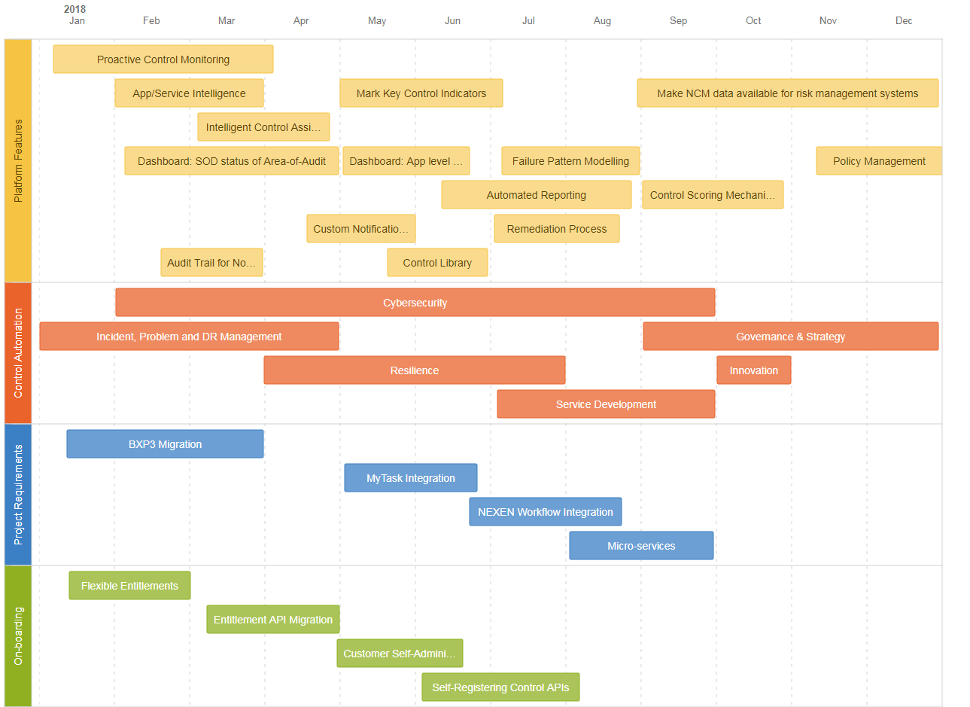
Integrated Roadmap : 2018

Slide 16
Tools Evaluated
 | IBM (OpenPages) | EMC (RSA Archer) | MetricStream | ControlCase
Strength | Primary buyer identification — IBM understands the needs of risk and security professionals, and does a good job of targeting the needs of those roles. Geographic strategy — As a global vendor, the vendor provides local sales, engineering and support all around the world. | Market understanding —fulfillment of critical needs, customer understanding and insight into primary buyer identification Product roadmap — The roadmap actively considers input from customers Geographic strategy —has partnerships in each region with consulting service providers, system integrators and value-added resellers. | Product features/functions — above-average performance of individual capabilities. IT risk assessment automation, control mapping to requirements and application risk assessments, in particular. Geographic strategy — Local sales, support and engineering across the globe help demonstrate a focus on emerging opportunities in more regions. Innovation — improving deployments and demonstrating better time to value | Low product pricing and quick time to deliver value lead to lower total cost of ownership. Product features/functions — strong focus on compliance, coupled with providing the offering as a service Customer satisfaction —Above average feedback. Also for Support availability/response times
Caution | Customer experience — A lack of dedicated ITRM expertise was cited as an issue during implementation. Customers have also indicated that configuration was sometimes overly complicated. Additionally, not having the right level of expertise available is a challenge for support. On-premises only — For buyers interested in off-premises options, IBM OpenPages' ITRM capability is not offered as a SaaS solution. No support for data-driven Control Strength analysis. | Customer experience — Primitive Product implementation methodology and ease of implementing new software releases Clarity of pricing and TCO — Customers prefer to see line items for license and maintenance costs, and to gain insight into spread of maintenance cost over a period of years to be able to calculate the total cost of ownership of the software. No support for data-driven Control Strength analysis. | Lack of Overall customer experience, specifically pricing and product implementation approach. Complexity in Customization —deployments have required a high level of customization. Clarity of pricing — Customers want to see more detail related to maintenance costs, and to be able to calculate total cost of ownership over a period of time No support for data-driven Control Strength analysis. | Lack of Industry experience —does not provide expertise in a wide range of industries. Difficult implementation of new software releases/version upgrades No support for data-driven Control Strength analysis.

